Slide 1
Lesson 6 - Example: Random Ghosts
Mr Mack 2019

Slide 2
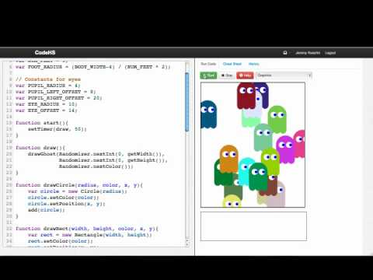

Slide 3
How can we make our code reusable?
Use constants instead of magic numbers
Use parameters in our functions instead of specific values
Write multiple functions that solve small subproblems rather than one function that solves the entire problem.
All of the above

Slide 4
Which function has better reusability?
function drawRectangle(x, y, width, height, color){
//Draw a rectangle using the parameters as properties
…
}
function drawAGreenRectangleInTheTopLeftCorner(){
//Draw a green rectangle in the top left corner of the
//canvas
…
}

Slide 5
Why do we want our code to be “reusable”?
To avoid writing similar code multiple times
To avoid solving the same problem over and over again
To save time
All of the above

Slide 6
Example: Random Ghosts
This is an example for this lesson. You are encouraged to play around with it, run and change the code, and learn how it works. When you are done, click continue to go to the next problem.

Slide 7
Example: Random Fireworks
This is an example for this lesson. You are encouraged to play around with it, run and change the code, and learn how it works. When you are done, click continue to go to the next problem.

Slide 8
Exercise 3.6.1: Circle Wall
Program Result
Write a program that draws a wall of circles one at a time using a timer. Every DELAY milliseconds, it should draw one circle.
Start by drawing one in the top left corner and then draw circles to its right until you finish one row. Then draw circles on the next row. The circles should alternate between the colors red and black.
When you have drawn circles covering the entire screen, stop your timer.
Hint: You can’t use a for loop or while loop here, since you need to draw on a timer.

